Slide 1
WASHINGTON REPORT
JEDA BOND SUMMIT
October 28, 2016
Mike Rock
American Hospital Association
mrock@aha.org.
(202) 626-2325
Chuck Samuels
Mintz Levin
casamuels@mintz.com
(202) 434-7311

Slide 3
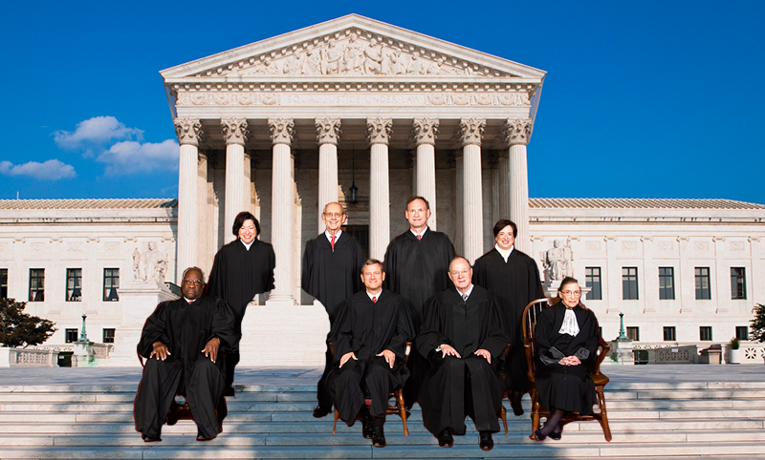
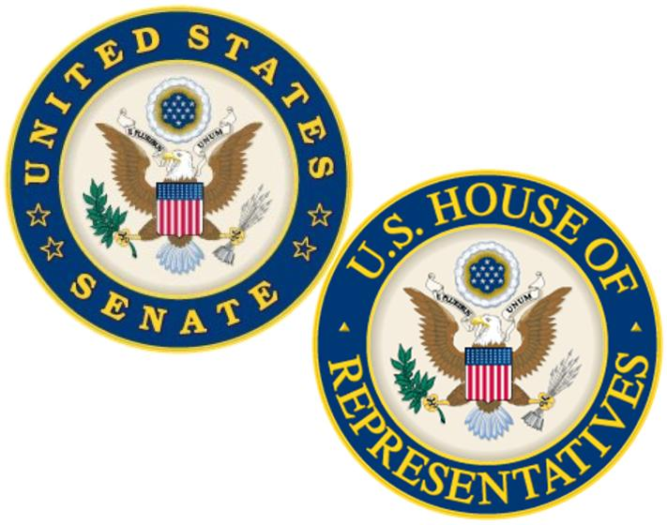
Elections Matter
Supreme Court
Congress…Senate
Tax Reform
ACA coverage provisions
Medicare and Medicaid… funding and structure
Rx prices
Notes:
Next president may have the opportunity to appoint four new justices
Scalia Seat
Ruth Bader Ginsburg, at 83, is most likely to retire next
While neither has indicated an intent to retire, Justice Breyer and Justice Kennedy will both be in their 80s by the 2020 election.

Slide 4
Voter Frustration
Historic Lows for Both Candidates
Results from ABC News/Washington Post Poll, Aug 24-28
Clinton Sees Substantial 7-Point Drop in Favorability During the Month of August
Donald Trump Remains Steadily Unfavorable, Trending Downward Among His Base
Source: National Journal; ABC News/Washington Post poll conducted between August 24 and 28, 2016. 1,020 adults surveyed over the phone with a margin of error of 3.5 points.
Notes:
We assume that you are following the Presidential race to some extent, but we want to highlight a couple things for you.
We talked about this unique aspect of the Presidential campaign the last time we met, and it’s holding true today – both nominees have historically high unfavorable ratings. This is a poll from the end of August and it shows both candidates are well above 50% negative ratings from voters. In fact, there was a large impact on Clinton from where she was polling just after the convention.
This could be the first elec­tion in which more people vote against a can­did­ate than in fa­vor of one – it’s a situation where people are asking themselves, “Who do we dislike the least?”
It could certainly have an effect on turn out as voters choose between being discouraged and staying home or being encouraged to vote against a candidate they dislike. They could also defect to third party candidates, who could possibly see larger support than in past years.
Poll­sters can try to guess about the electorate, but these voters are so con­flic­ted that polling may not be of much help in pre­dict­ing what they will do on Elec­tion Day.

Slide 5
Voter Frustration
Historic Lows for Both Candidates
Notes:
We assume that you are following the Presidential race to some extent, but we want to highlight a couple things for you.
We talked about this unique aspect of the Presidential campaign the last time we met, and it’s holding true today – both nominees have historically high unfavorable ratings. This is a poll from the end of August and it shows both candidates are well above 50% negative ratings from voters. In fact, there was a large impact on Clinton from where she was polling just after the convention.
This could be the first elec­tion in which more people vote against a can­did­ate than in fa­vor of one – it’s a situation where people are asking themselves, “Who do we dislike the least?”
It could certainly have an effect on turn out as voters choose between being discouraged and staying home or being encouraged to vote against a candidate they dislike. They could also defect to third party candidates, who could possibly see larger support than in past years.
Poll­sters can try to guess about the electorate, but these voters are so con­flic­ted that polling may not be of much help in pre­dict­ing what they will do on Elec­tion Day.

Slide 6
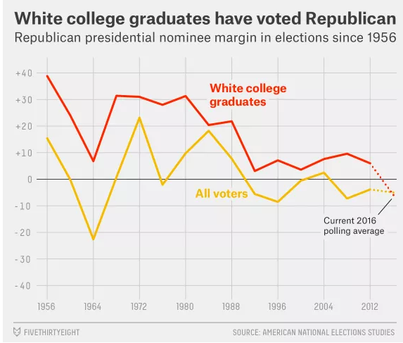
Shifting of White College Educated Voters
Trump May Become The First Republican In 60 Years To Lose White College Graduates
Source: Five Thirty Eight, July 6, 2016
Notes:
Here’s something else that is unique about the Republican nominee - he is on a track to lose white college graduates.
That’s really unusual for a Republican, and it means that among white voters overall, he’s probably not holding a winning hand.
Trump’s performance is downright shocking from a historical perspective: the American National Elections Studies shows Republicans carrying that group in every election from 1956 to 2012.
He is doing well among non college educate whites, and they helped him secure the Republican nomination, and he will need their help in a couple key states.

Slide 7
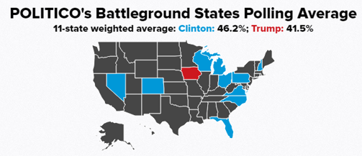
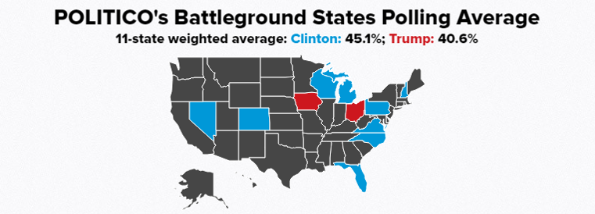
Key States – Presidential Race
State | Clinton Average | Trump Average
Colorado | 45 | 38.6
Florida | 46.8 | 43.4
Iowa | 39.8 | 44.6
Michigan | 46.4 | 37.6
Nevada | 45.8 | 42.2
New Hampshire | 45.8 | 39.2
North Carolina | 47.4 | 43.8
Ohio | 45 | 46.2
Pennsylvania | 48.4 | 41.2
Virginia | 47.2 | 35.6
Wisconsin | 46.4 | 41.4
Source: POLITICO Battleground States polling average, 10/2416
Notes:
Let’s take a closer look at some of the battleground states to see how the candidates are polling.
You may have seen individual national polls that show that Clinton is down- this slide reflects averages from a number of polls taken in these key states over the last few weeks.
You can see that the race is tightening in Iowa, Nevada and Ohio. Those states went Democratic the past two elections, but are looking more favorable for Republicans this time around.
Trump was expected to do better in traditional blue states – such as PA, MI, and WI – and that would be enough for him to get to 270 in the electoral college. This is because of one of Trump’s strengths — his disproportionate support among blue-collar, non-college-graduate white voters.

Slide 8
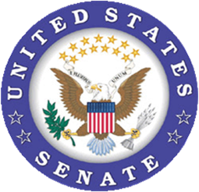
GOP Senate Challenge
Republicans will defend 24 seats
7 in states that President
Obama won
Democrats will defend 10 seats… all in states that President Obama carried in 2008 and 2012
Key Races:
- Illinois
- Wisconsin
- Indiana
- New Hampshire
- Pennsylvania
Notes:
As we’ve mentioned before, all eyes are really focused on the Senate to see if Republicans will be able to maintain their majority.
The numbers are not in Republican’s favor. As you can see here, Rs are defending 24 seats, while the Democrats are only defending 10.
Also, this is a presidential year where voting demographics tend to favor Democrats, as opposed to mid-term years where Republicans are usually more successful.
But with less than two months until Election Day, Democratic confidence has been shaken, as Hillary Clinton suddenly finds herself trailing Donald Trump in some swing states and a fresh batch of polls show GOP incumbents in the lead.
Current make-up of Senate: 54 Rs, 44 Ds, 2 Independents (VT & ME), so the Democrats need to flip 5 seats total to take the majority which is definitely possible.

Slide 9
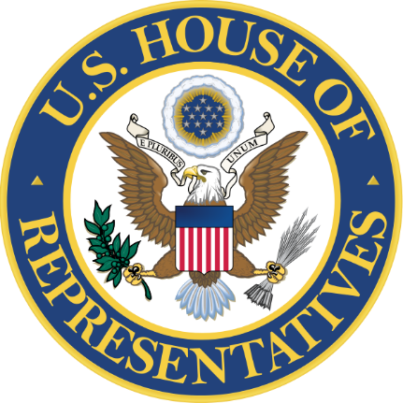
House Unlikely to Flip…But…
Risk Factors For GOP Incumbents 2016
Obama won the district in 2012
Incumbent won with less than 55% of Vote in 2012 / 2014
High % minority population in the district
High % voters with at least a bachelor’s degree
Well-funded Democratic opponent
Most Vulnerable
Mike Coffman (CO-6)
Carlos Curbelo (FL-26)
Robert Dold (IL-10)
Martha McSally (AZ-02)
Jeff Denham (CA-10)
Scott Tipton (CO-3)
Ileana Ros-Lehtinen (FL-27)
Rod Blum (IA-01)
David Young (IA-03)
Crescent Hardy (NV-04)
Frank Guinta (NH-01)
Scott Garrett (NJ-05)
Lee Zeldin (NY-01)
Source: The Cook Political Report, 9/12/16
Notes:
The conventional wisdom is that the Republicans will hold the House – the question is, by how much?
A recent WSJ article highlighted that some Republicans are worried their internal divisions could intensify if their majority shrinks and they lose many of their most centrist colleagues.
The GOP lawmakers most vulnerable in November are also those most willing to cross the aisle on policy. Reps. Bob Dold of Illinois and Carlos Curbelo of Florida have supported some new curbs on gun sales, while Rep. Mike Coffman of Colorado has broken with his party on some immigration proposals.
Democratic leaders may stand to benefit if Mr. Ryan loses some of the Republicans on whom GOP leaders count to vote for bills opposed by many among the party faithful. Republican leaders already often lose 40 or more GOP votes on contentious legislation including must-pass spending bills, giving leverage to Democrats, whose votes are needed for the bills to pass. Conservatives say they are sticking to their principles and that a GOP-controlled Congress should make fewer concessions to Democrats.

Slide 10
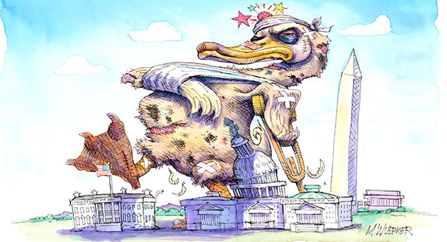
Lame Duck Agenda
Bipartisanship Name of the Game
Keep government open
CR / Omnibus
Hospital ‘Bill’
Section 603 fix
Socioeconomic adjustment for HRRP
RCH demo extension
No significant tax action expected
Notes:
The topics the will tackle during the lame duck session depends in great part on who wins the election.
No matter who wins, they will have to keep the government funded. The question usually is for how long.
And if the final OPPS rule does not come out as we would have hoped, we will need Congress to use the “hospital bill” as the basis for making additional changes beyond those listed on this slide.

Slide 11
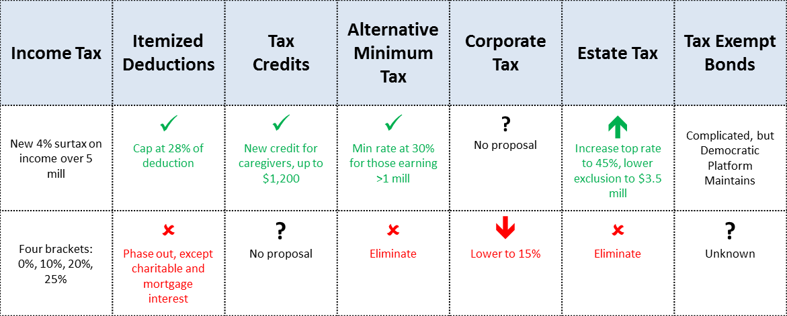
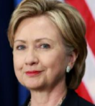
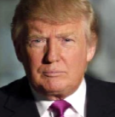

Slide 12
Potential Nominees for Treasury Secretary in Clinton Administration
Sheryl Sandberg
COO, Facebook
President's Council on Jobs and Competitiveness, 2011-2013
Lael Brainard
Under Secretary for International Affairs, 2010-2013
Economic Policy, Obama Transition Team, 2008-2009
Gene Sperling
Director, National Economic Council, Clinton/Obama Administrations
Former Treasury Department official

Slide 13
Potential Nominees for Treasury Secretary in Trump Administration
Carl Icahn
Icahn Enterprises L.P.
Board of Directors, American Property Investors, Inc.
Chairman of the Board, Starfire Holding Corp.
Board of Directors, CVR Energy, Inc.
Steven Mnuchin
Co-Founder, Co-Chief Executive Officer, and Chairman, Dune Capital Management LP
Co-Founder, Chairman, and CEO, OneWest Bank Group LLC

Slide 14
"Tax reform is no longer optional….it is essential. If we're going to get our economy moving again, we need a tax code that will stop standing in the way. And, make no mistake, promoting job creation and economic growth is the first and most important step we need to take in order to address our nation's most pressing problems. " – Senator Orrin Hatch (R-UT)
"There is no question its long past time that we reform our badly broken and overly complicated tax code. Few would disagree that we need a fresh set of simple rules that creates good jobs at home, helps our county compete and win internationally and is fiscally responsible." – Senator Ron Wyden (D-OR)
Chairman
Ranking Member

Slide 15
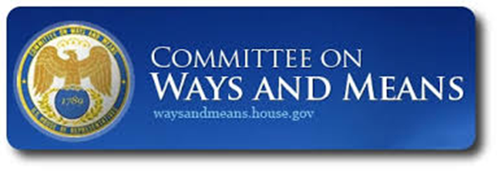
"We need a simpler, fairer tax code that protects taxpayers, not special interests – and helps America compete and win."
– Rep. Kevin Brady (R-TX)
"We need to be clear and specific about what we hope to accomplish. We need tax reform that protects working families, encourages economic growth and domestic job creation, and is fiscally responsible." – Rep. Sandy Levin (D-MI)
Chairman
Ranking Member

Slide 16
Key Recent Actions on Tax Reform

Slide 17
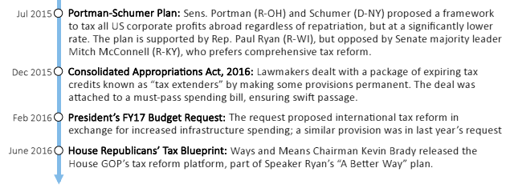
Key Recent Actions on Tax Reform

Slide 18
Looking Ahead: Tax Reform
No action expected in post-election lame duck session but look for renewed efforts in 2017 no matter who is elected president
Sen. Chuck Schumer (D-NY) is expected to lead Senate Democrats in 2017 and has suggested he will work with House Speaker Paul Ryan (R-WI) to pass a bill focused on international tax reform
Senate Majority Leader Mitch McConnell (R-KY) has ruled-out that approach and stated a preference for one comprehensive package
House Ways & Means will begin drafting legislation according to the recently released GOP tax blueprint, with the goal of passing legislation in 2017 - Likely eliminates tax exempt bonds
Action at Senate Finance Committee also likely in 2017
Tax Reform = 2 Year Campaign

Slide 19
Tax Reform Prospects
Likely under any election result.
Unlikely Tax Exempt Bonds will be untouched.
Fundamental reform or trim at the edges?
Private activity bonds in jeopardy?
Tenuous position for non-profit bonds.
Recent discussions on stadia and college endowments

Slide 20
HR 2229 S 3257- Municipal Bond Market Support Act
Bipartisan bicameral legislation that would increase the bank qualified debt limit from $10 million to $30 million and apply limit to borrowers.
BQ debt helps smaller issuers reduce debt issuance costs
(typically 25 to 40 basis points)
25 – 40 bps costs savings on a 15-year, $10M bond = $232K - $370K
25 – 40 bps cost savings on a 15-year, $30M bond = $696K - $1.1M

Slide 21
HR 2209 – High Quality Liquid Assets Legislation
9/3/14 - Federal Reserve, FDIC, and Comptroller Of Currency approved new liquidity standards for banks.
New rules are a response to the 2008 financial crisis and will require banks with at least $250B in total assets to maintain designated levels of high-quality liquid assets (HQLA - assets that can easily be converted to cash) during a 30-day fiscal stress scenario.
Rule classifies foreign sovereign debt securities as HQLA while excluding investment grade munis!
Excluding munis from HQLA means banks could not use municipal securities to satisfy the liquidity coverage requirement of the new rules.
1/1/15 - Rules went into effect.

Slide 22
MMF Regulation
October 14 SEC money market rule – NAV from fixed to floating – avoid large scale withdrawals.
Effect on MMF muni holdings.
Legislative fix.

Slide 23
SEC – MCDC Initiative
Standardized and “Favorable” Settlement Terms
Issuer will consent to a cease and desist order, which they will have to carry on their future official statements for 5 years.
Issuer agrees to further cooperate with any additional SEC investigations, including those regarding the roles of individuals involved.
No monetary penalties for issuers, however the SEC reserves the right to impose monetary fines on individuals who it determines are at fault for violating federal securities laws.
Issuer agrees to establish appropriate continuing disclosure policies, procedures and training and update its past delinquent continuing disclosure filings.
Future implications for Issuer/Borrower Regulation and Legislation.

Slide 24
SEC – MCDC Initiative
2014 Initiative to improve continuing disclosure compliance by compelling government bond issuers to self-report violations of federal securities laws.
Initiative offered issuers standardized and “favorable” settlement terms if they self-reported instances of inaccurate statements in bond offering documents about their prior continuing disclosure obligations.
August 24, 2016 SEC Announces 71 settlements against issuers and obligated persons

Slide 25
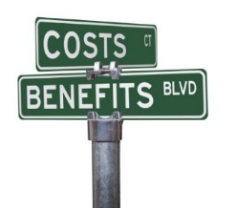
Hospital Challenges
Value-Based Payment
New Doc Payment System
Insurer Consolidation
Drug Price Increases
Regulatory Reform
Marketplace Stability
Notes:
The key driving force before Congress leaves town to campaign is how to fund the federal government before the fiscal year ends on Sept. 30 in order to avoid a government shutdown.
Right now, the approach is a stop gap measure until December 9th – this is favored by most everyone except the House Freedom Caucus. The Senate is acting first to put pressure on the House.
We may also see some activity on some key health care bills before they leave town.

Slide 26
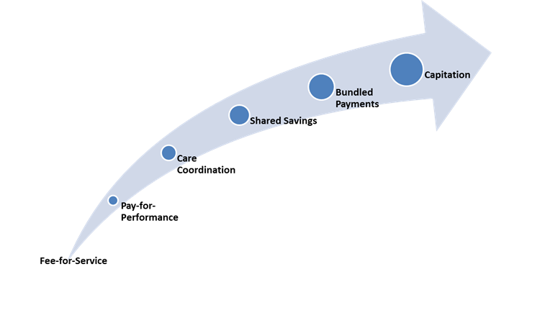
Value-Based Payment
30% of payments thru APMs by 2016, 50% by 2018
Bundled Payment
Shared Savings
477 ACOs
Notes:
The key driving force before Congress leaves town to campaign is how to fund the federal government before the fiscal year ends on Sept. 30 in order to avoid a government shutdown.
Right now, the approach is a stop gap measure until December 9th – this is favored by most everyone except the House Freedom Caucus. The Senate is acting first to put pressure on the House.
We may also see some activity on some key health care bills before they leave town.

Slide 27
Medicare Physician Payment
Rule Takes First Step in Physician Payment Reform
67% of Physicians Employed by or Contract with Hospitals
Hospitals Defray Cost of Implementation, Compliance + Accept Risk
Barriers to Teamwork
Stark Law
Anti-Kickback
AHA Safe Harbor Proposal

Slide 28
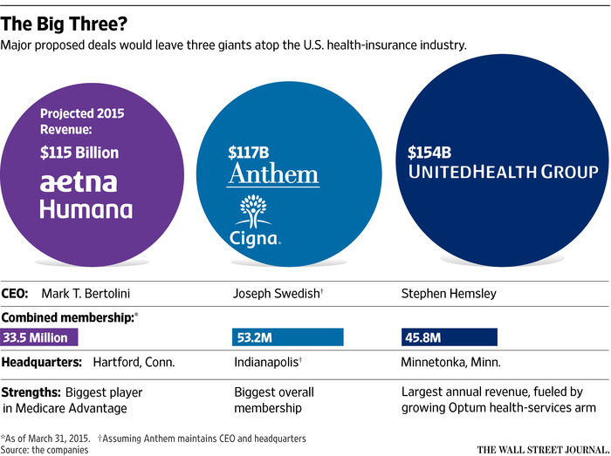
Insurer Consolidation
DoJ Expected to Announce Decision This Year
BlueCross affiliation

Slide 29
Drug Pricing
AHA: steering committee member - Campaign for Sustainable Rx Pricing
AHA/FAH Drug Pricing Study October 11, 2016
Major Findings:
Significant growth in inpatient drug prices and spending
Drug spending challenges hospital budgets
Most growth in non-innovator drugs
AHA drug policy solutions
Notes:
POLICY
Here’s a quick update of where we are on the issue of drug pricing:
The focus on drug pricing has not diminished, in large part due to a spike in the price of EpiPens, which caused significant consumer backlash over social media and in the mainstream press. Both Republican and Democratic policymakers have demanded answers from the drug manufacturer, Mylan, who now faces a hearing before the House Oversight committee. Due to the public outcry, the manufacturer has agreed to slightly decrease the price of branded EpiPens and release an “authorized” generic for ½ the price (which is still 200% more expensive than the cost of the drug when the manufacturer bought it in 2007 - $300 vs. $100). Some suspect that the FDA may expedite the approval of a much lower cost generic alternative that has been in development to provide consumers with relief.
With respect to our work, the AHA and the Federation of American Hospitals, working with the research firm NORC, are close to the release of our study on changes in drug prices and spending in the inpatient setting. Our study – based on the responses of more than 700 hospitals and data from two GPOs that represented 1,400 hospitals – found significant growth in drug spending, which was even greater when you looked at that spending on a per admission basis. Nearly all responding hospitals also said that high and rising drug prices were challenging their ability to manage their budgets.
We plan to release the study in mid-October through press and Hill events. We will simultaneously release the AHA’s set of policy proposals that the Board approved this summer with your input.
We know many of you care about 340B, as well. I will note that final guidance from HRSA is currently under review by OMB, which is the last step before release. As you know from previous discussions, steps by HRSA will be more favorable to hospitals than any legislative action we might see.
TURN OVER TO LOBBYIST TO FINISH REMAINDER OF PRESENTATION

Slide 30
Regulatory Onslaught
Hospital Related Rules through Sep. 9
Program Integrity Rules
Other Rules
12,500
CoP Rules
MA and Exchange Rules
10,000
14,625 pages
Medicaid Rules
Number of Pages
Delivery and Payment Reform Rules
7,500
5,000
FY and CY Medicare Payment Rules
2,500
Notes:
POLICY
NOTE: THE 14,625 BOX IS ANIMATED AND APPEARS UPON CLICK
Recent laws and CMS’s own agenda have resulted in a landslide of rules in 2016 to date.
Specifically, thru Sept 9, we saw 38 proposed and final rules, which is a bit over 1 per week.
And it’s a total of almost 15,000 pages. A record amount. It is normal for an outgoing administration to issue a suite of rules in its final year, but this administration has been more active that any previous outgoing administration.
All of these rules certainly keep us busy – but we are most concerned about the impact all of these rules have on the field.
That is why we will have a session later in the agenda on regulatory relief.
NOTE TO PRESENTER, RULES COUNTED ABOVE ARE LISTED IN EXCEL SHEET IN RESOURCES FOLDER

Slide 31
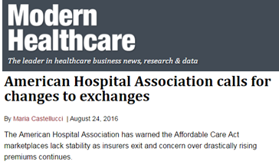
Marketplace Stability
Insurer exits threaten access to coverage (United, Aetna, Humana)
No legislatively permitted “fallback plan” available
Insurers seeking rate increases & improvements to risk pool
AHA pursuing regulatory fixes
Notes:
POLICY
The public marketplaces have suffered some significant blows this year with a number of high profile insurer exits. United had announced a retrenchment earlier this year. However, they primarily left markets where they had minimal presence. The Aetna exits, however, leave approximately a million consumers needing to find new coverage. We won’t know until late September exactly what options will be available to consumers in each market, including if there are markets without any options. (NOTE: Just prior to round 2 RPBs we will know the full situation in terms of counties with few or no options.) The ACA does not include a “fallback” provision or alternative coverage option. Therefore, it’s possible that some consumers will not have a plan available to them.
The major challenges with the marketplaces are lower than planned enrollment, a higher rate of sicker people enrolled, and mis-pricing on the part of insurers in 2014 and 2015 that perpetuates.
Insurers are seeking rate increases and mechanisms to improve the risk pool. The AHA has advocated for the agency to use its levers to stabilize the marketplaces, including through refining the risk adjustment program, tightening up the special enrollment periods, increasing outreach and enrollment, and exploring state wrap-around efforts. In late August, CMS released the proposed rule governing the marketplaces for 2018. The agency proposed several of the changes we advocated for, including refinements to the risk adjustment program. However, we suspect more must be done to stabilize the marketplaces.
(Note: the graphics show: map of what we know so far about options available to consumers. Red is no plan (1 county); yellow is 1 plan; blue is 2 plans. Rest of the country has 3 or more plans. The other is the recent letter AHA sent to CMS asking for changes and some of the trade coverage of that letter.)

Slide 32
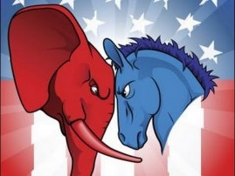
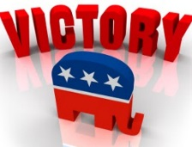
2017 and Beyond…
Some Scenarios
Democrats Sweep ACA tweaks Public option/Medicare at 55 Providers as pay-fors Republican opposition in Senate Reconciliation | Trump Wins Democrats Control One Chamber Stalemate ACA Medicare expansion Medicaid block grants Triangulation?
Clinton Wins GOP Control One Chamber Stalemate ACA Medicare expansion Premium support Medicaid block grants Triangulation? | Republicans Sweep ACA repeal Replace/triangulation? No Medicare expansion Medicaid block grants Deficit reduction? Democratic opposition in Senate Reconciliation
Notes:
This slide has a lot of information on it and may look confusing but I won’t go into all of this detail.
Should one party sweep, the White House and both Houses of Congress, they will able to do more to change health care programs such as the ACA and Medicare and Medicaid. Note that even if there is control in both Houses of Congress, it is unlikely that either party will have the 60 votes necessary to prevent a filibuster in the Senate, so they would have to use the reconciliation process to get major changes through that chamber.
If there is divided government, we will likely see a stalemate in Washington and there will not likely be major policy changes.
Though there could be opportunities for whoever is president to strike deals with members of the opposite party – this is something that Bill Clinton was very good at doing when he was in his second term in office – this is also called triangulation.

Slide 33
Future of ACA for GOP
No longer a theoretical debate
Tens of millions benefit
Kids until 26 on parent’s plans
Insurance reforms
Alternative necessary for coverage…tax subsidies
Notes:
If the GOP takes over, it may not be so easy for them to get rid of the ACA. This is because there are millions of people benefitting from the program and some of the insurance reforms that were part of the ACA are very popular – such as allowing children to stay on their parent’s health insurance plan to the age of 26.
There will have to be some consideration for alternatives – perhaps through what is outlined in Paul Ryan’s “Better Way” plan.
The concern we have is will they be able to provide health care coverage to the same amount of people who are currently benefiting from the program?

Slide 34
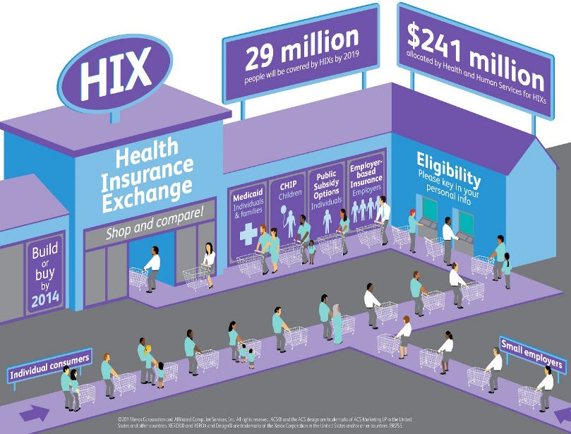
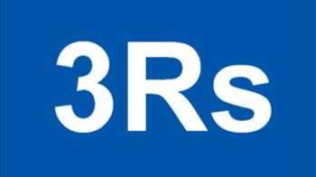
Regardless of Election
Viability of insurance exchanges
Premium increases
The three “R’s”
Risk adjustment
Reinsurance
Risk Corridors
Out of pocket expenses
Network adequacy
“Public program”
Notes:
Regardless of who wins, they will have to do something to address the situation with the insurance marketplaces.
You may have heard that President Obama recently met with leading insurance executives, making a direct plea for their continued commitment to the health law despite its recent spate of difficulties. Later this month, he'll host a "Millennial Outreach and Engagement Summit" at the White House, too.
There is precedent for congress stepping in to help out when a program is not going well – the most recent examples are the roll out of the Medicare Advantage Program and the drug benefit through Medicare Part D. But there has to be the political will to take action.
Also, we should be prepared for Congress to again scrutinize the not for profit status of hospitals as they look for additional sources of revenue. This could be a discussion that happens in the larger tax reform debate that we think could start in earnest after the election.

